Slide 1
617540-EPP-1-2020-1-IT-EPPKA2-CBHE-JP PICASP Pilot Courses and new didactics for teachers training in cultural tourism for the development of Caspian Area
European Commission
Education, Audiovisual and
Culture Executive Agency (EACEA)
Dr. Fariz KHALILLI – MIRAS

Slide 2
MIRAS Social Organization in Support of Studying of Cultural Heritage was established on 6th January, 2010 and registered on 31st March 2010 by Ministry of Justice of the Republic of Azerbaijan. Basic purpose is to assist in study, protection and promotion of cultural heritage.
Idea:
Ulduz Khalillova
Design:
Intigam Muhammedli

Slide 3
Mission:
To study, protect and promote local and international cultural heritage; to assist in fulfillment of scientific-research work on study of cultural heritage; to research and promote national-moral values; to repair and restore historical monuments and other objects; to study forgotten traditions and deliver next generation passed from one generation to other, including customs, practices, places, objects, artistic expressions and values; to focus on the similarities between the various heritage sectors, along with their differences.

Slide 4
Main Activities:
Arranges various courses and seminars, round tables and meetings, exhibitions and tours; holds local and international conferences, symposiums, charitable marathons, festivals and other cultural mass events in the line of study, protection and promotion of tangible and intangible heritage. Realizes projects on local and international level. Supports and coordinates collaborations of educational institutions, scientific institutions, museums, cultural heritage foundations of different countries like Turkey, Italy, Georgia, Russia, Spain, Belgium, Romania, North Macedonia, India, Iran, etc. Shares experience of educational institutions in Azerbaijan and Europe introducing European standards creates integrated projects.

Slide 5
SOME PROJECTS:
Development and Promotion of Archaeological Tourism in Azerbaijan
Protection and Promotion of Historical and Cultural Monuments in Azerbaijan: Monitoring of Current Situation and Obligations
Cities of Common Cultural Heritage International Archaeological-Tourism COMCEC project
Clean Village - Protection of Ecological and Ethnographic Identity with Participation of Local Communes and Sustainable Development
Tourism Perspectives of Archaeological Monuments and Support to Disabled Rehabilitation
The Role of Women in Rural Lifestyle Development

Slide 6
SOME PROJECTS:
Exploration, Preservation and Promotion of Medieval Aksu City
AKSUTECH: Use of Modern Innovative Methods in Teaching Technical Subjects at School
ArchaeoSchool: From the Past to the Future - Increasing the Continuity of History Teaching
I am a Lamb Pasture, I have a Lamb: Establishment of Tarakama/Transhumance Folklore Research and Promotion Group at School
Establishment and Continuous Operation of the Girdiman Guide Club for Schoolchildren
Research of Transhumance Traditions in Aksu, Publication of the Book and Holding Seminars

Slide 7
Dr. FARIZ KHALILLI
Historian, archaeologist.
Founder and owner of MIRAS.
Director of "Medieval Aksu Town" State Historical-Cultural Reserve of the State Service for Protection, Development and Restoration of Cultural Heritage under Ministry of Culture of the Republic of Azerbaijan
Manager or expert of many MIRAS projects.
He organized many cultural heritage tours in Azerbaijan, Turkey, Georgia, Italy, North Macedonia, Iran and etc.

Slide 8
GULSHAN N. HUSEYNOVA
Journalist, translator, expert of ecology and cultural heritage, event organizer, expert GİS and database in the CEP/TACİS.
Member of Public Organization of Azerbaijani carpet weaving (Azerbaijani Carpet Makers' Union), since 2010
Member of MİRAS, since 2013.
She is the head of the official website of the Main Department of Culture of the city of Baku;
the artistic director of the House of Culture of the Sangachal settlement;
the curator of SMM Group of the Main Department of Culture of the city of Baku;
Director and Founder of the Translation and Educational Center "LHG Company".

Slide 9
GULSHAN N. HUSEYNOVA
She participated in the implementation of activities within the MİRAS of the country, in the implementation of projects and exhibitions, preparation of proposals, etc. preservation, study and promotion of the cultural heritage, participated in organization 2nd, 3rd and 4th International Tarakama Folk Art Festival (2016, 2018, 2019).
From April 2015 to November 2, 2016, She conducted trainings for students from Azerbaijan and Belgium as an environmental trainer within the ERASMUS+ Program in Azerbaijan and Belgium.
May-November 2016. She was an expert and co-author of the project and book "The role of women in rural life development", carried out by the MIRAS which promotes the study of cultural heritage.

Slide 10
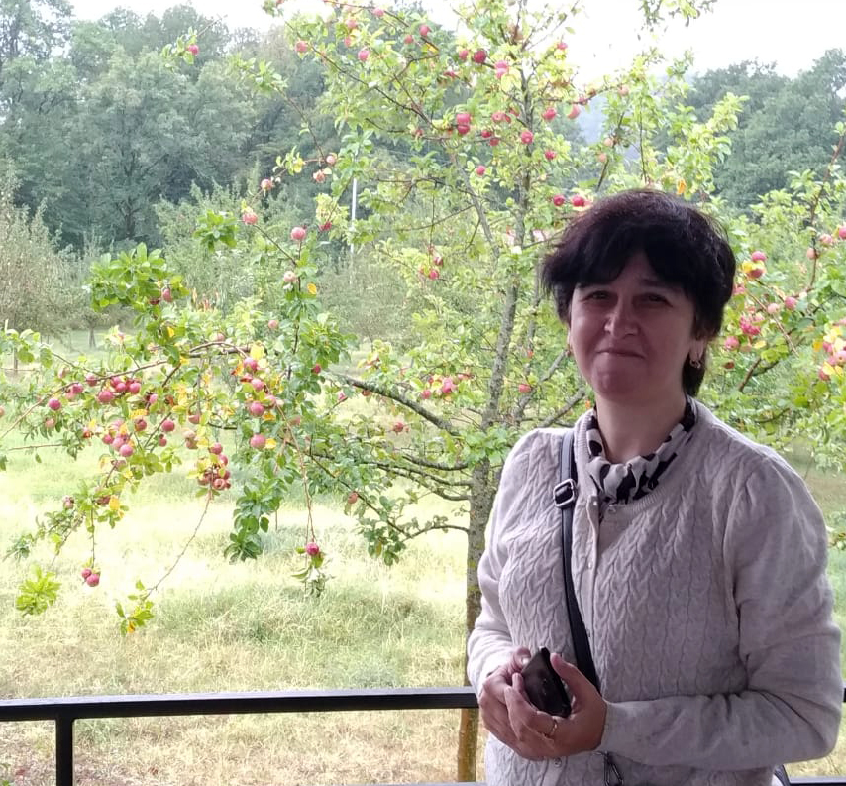
GULSHAN N.
HUSEYNOVA
On May 27-29 the 2014th year was a co-reporter on the subject "The Clean Village - Participation of Local Communities in Preserving Ecological and Ethnographic Identity" at the IV International YOCOCU Conference. The article was also published in the scientific journal "Cambridge Scholars Publishing".

Slide 11
Dr. GUNEL SEYIDAHMADLI:
Graduated from the Azerbaijan State Academy of Arts, Faculty of Art Studies, majoring in "History and Theory of Fine Arts" with a bachelor's and master's degree. In 2017, she defended her dissertation entitled “Artistic features of Azerbaijani memorial sculptures” (based on the monuments of the Alley of Honors) and in 2018, received the title of Doctor of Philosophy in Art History.
Since 2015, she has been working as a senior lecturer at the Department of History and Theory of Fine Arts of the Faculty of Fine Arts at Azerbaijan State University of Culture and Arts, and in 2018-2020, she served as Deputy Dean of the same faculty.

Slide 12
Dr. GUNEL
SEYIDAHMADLI:
Took an active part in about 20 foreign international and national symposiums, forums and conferences.
To date, she has published more than 30 scientific articles both in the country and abroad, is the author of 8 curricula, a monograph and a textbook.
She has been a member of MIRAS since 2014;
Member of the board of MIRAS since 2020.

Slide 13
MALEYKA HUSEYNOVA:
Graduated from the International Law and International Relations faculty of the Baku State University with the master degree.
From the 2007 until 2018 has been working at the Ministry of Culture and Tourism of Azerbaijan Republic.
During this years has been responsible for the development of cultural tourism, has been coordinating the relations of the Ministry both with other countries’ Ministries and with international organizations (Europe Council, OIC, ECO, BSEC, CIS, ISESCO, Turkic Council, COMCEC) in the sphere of tourism.
As well as was the initiator or coordinator of different national and international projects in the sphere of cultural tourism such as “Alexander Dumas in the Caucasus”, “Wine, Culture, Tourism Exchange”, “Wine festival”, “Olive tree route”, “World heritage of the CIS countries” etc.

Slide 14
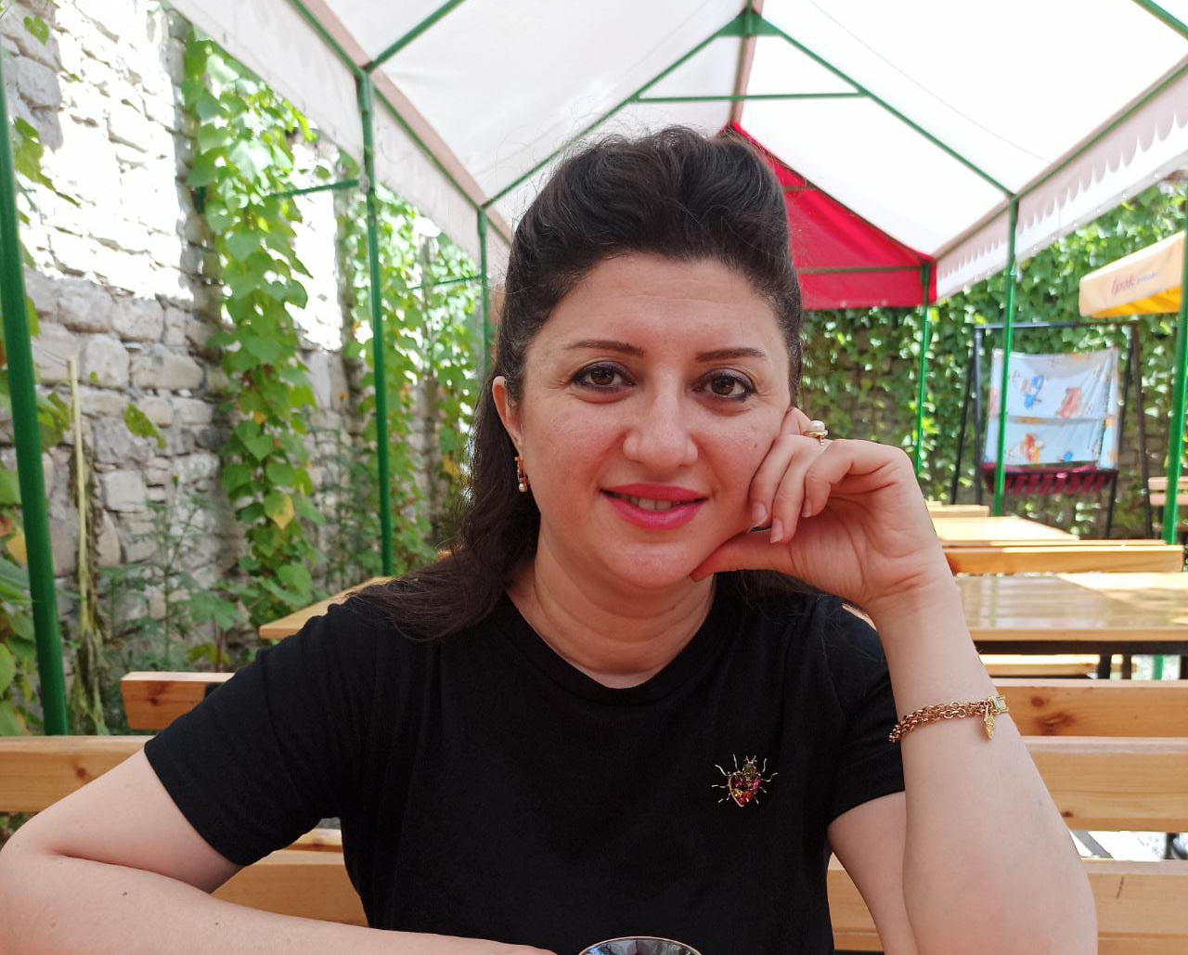
MALEYKA
HUSEYNOVA:
She also was the author and coordinator of the archaeological-tourism project “The Cities of Common Cultural Heritage” realized under the COMCEC grant program in the cooperation with “MIRAS” Social Organization in Support of Studying of Cultural Heritage.
She has been a member of MIRAS since 2015.

Slide 15
TƏŞƏKKÜR EDİRƏM!
MANY THANKS!

